Slide 2
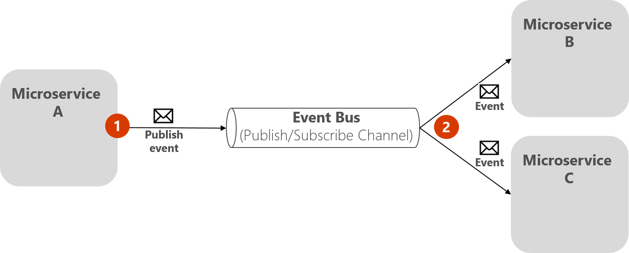
Event driven bus
一個bus(message queue) 每個service publish/subscribe it
And use is as a communication medium
Notes:
https://learn.microsoft.com/en-us/dotnet/architecture/microservices/multi-container-microservice-net-applications/integration-event-based-microservice-communications

Slide 3
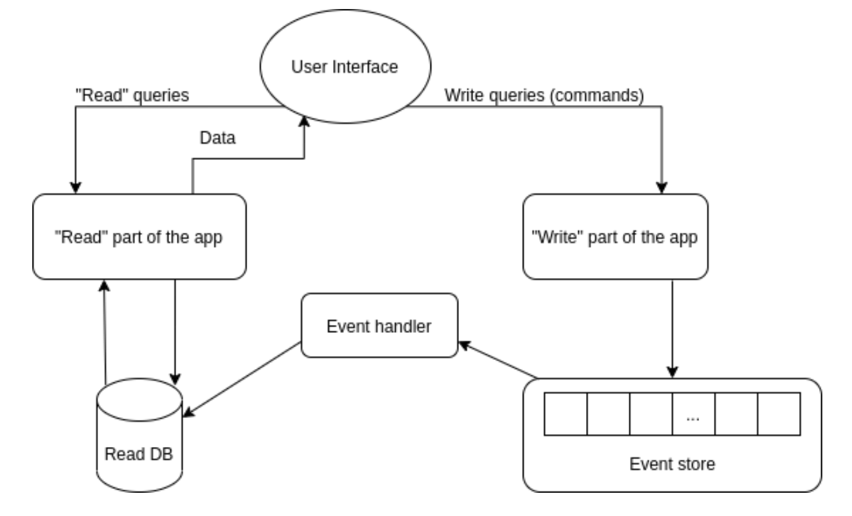
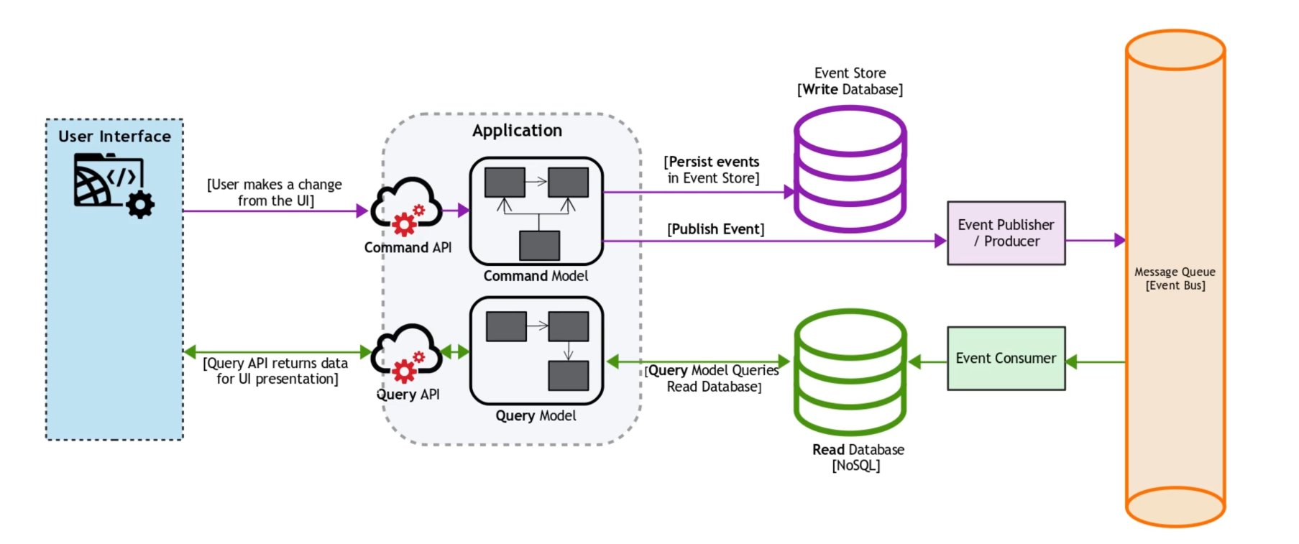
CQRS & Event sourcing
Event sourcing
A sequence of “states” that record the state of the data in a specific moment
So a sequence of event stores can help us to re-create or revert data
The sequence is persist in “event store” which can be our write db
Ex shopping cart
Notes:
https://www.upsolver.com/blog/cqrs-event-sourcing-build-database-architecture

Slide 4
SAGA pattern
What if we need many transactions spans across many microservices?
Distributed database transaction
Comply to ACID principle
All or nothing
SAGA – a sequence of local transactions
One micro service trigger one or more transactions in the list and pass the list to the next service
Choreography and Orchestration pattern

Slide 5
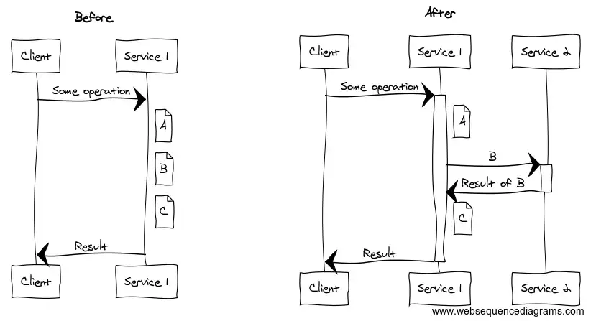
Cascading failure issue
Notes:
https://medium.com/@floyd.may/microservices-and-cascading-failures-16ec91c6ec9b

